Slide 1
Gradient Descent

Slide 2
Slide credits
Most of these slides were adapted from:
Hung-yi Lee (National Taiwan University)
Kris Kitani (Carnegie Mellon University).
Noah Snavely (Cornell University).
Fei-Fei Li (Stanford University).

Slide 3
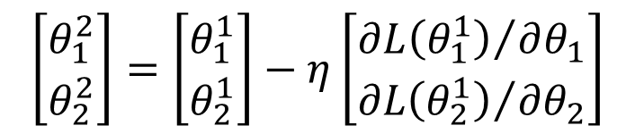
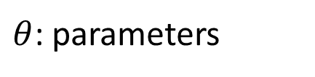


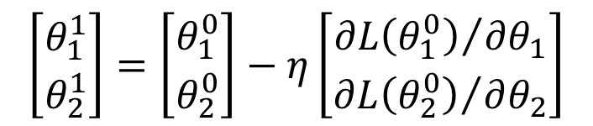
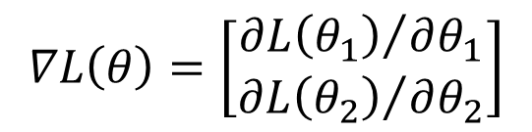
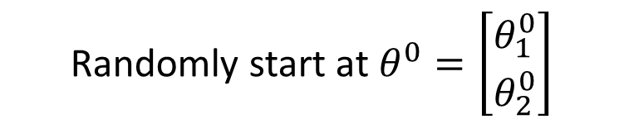

Review: Gradient Descent
In step 3, we have to solve the following optimization problem:
$$θ^{∗}=arg\min_{θ}{L\left(θ\right)}$$
L: loss function
$θ$: parameters
Suppose that θ has two variables {θ₁, θ₂}
Randomly start at $θ^{0}=\left[\begin{matrix}θ_{1}^{0} \\ θ_{2}^{0}\end{matrix}\right]$
$$∇L\left(θ\right)=\left[\begin{matrix}{∂L\left(θ_{1}\right)}/{∂θ_{1}} \\ {∂L\left(θ_{2}\right)}/{∂θ_{2}}\end{matrix}\right]$$
$$\left[\begin{matrix}θ_{1}^{1} \\ θ_{2}^{1}\end{matrix}\right]=\left[\begin{matrix}θ_{1}^{0} \\ θ_{2}^{0}\end{matrix}\right]−η\left[\begin{matrix}{∂L\left(θ_{1}^{0}\right)}/{∂θ_{1}} \\ {∂L\left(θ_{2}^{0}\right)}/{∂θ_{2}}\end{matrix}\right]$$
$$θ^{1}=θ^{0}−η∇L\left(θ^{0}\right)$$
$$\left[\begin{matrix}θ_{1}^{2} \\ θ_{2}^{2}\end{matrix}\right]=\left[\begin{matrix}θ_{1}^{1} \\ θ_{2}^{1}\end{matrix}\right]−η\left[\begin{matrix}{∂L\left(θ_{1}^{1}\right)}/{∂θ_{1}} \\ {∂L\left(θ_{2}^{1}\right)}/{∂θ_{2}}\end{matrix}\right]$$
$$θ^{2}=θ^{1}−η∇L\left(θ^{1}\right)$$

Slide 4





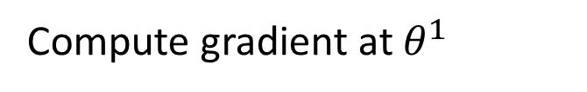


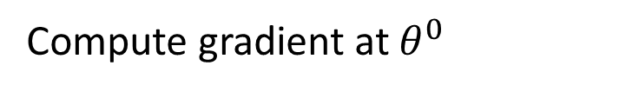

Review: Gradient Descent
Gradient: Contour line of normal direction of the loss function
$$θ_{2}$$
$$∇L\left(θ^{0}\right)$$
Start at position $θ^{0}$
$$θ^{0}$$
$$∇L\left(θ^{1}\right)$$
Compute gradient at $θ^{0}$
$$θ^{1}$$
$$∇L\left(θ^{2}\right)$$
Move to $θ^{1}$ = $θ^{0}$ - η$∇L\left(θ^{0}\right)$
$$θ^{2}$$
Gradient
Compute gradient at $θ^{1}$
Movement
$$∇L\left(θ^{3}\right)$$
$$θ^{3}$$
Move to $θ^{2}$ = $θ^{1}$ – η$∇L\left(θ^{1}\right)$
……
$$θ_{1}$$

Slide 5
Gradient Descent
Tip 1: Tuning your
learning rates

Slide 6
Learning Rate
Set the learning rate η carefully
If there are more than three parameters, you cannot visualize this.
Loss
Very Large
small
Large
Loss
Just make
No. of parameters updates
But you can always visualize this.

Slide 7
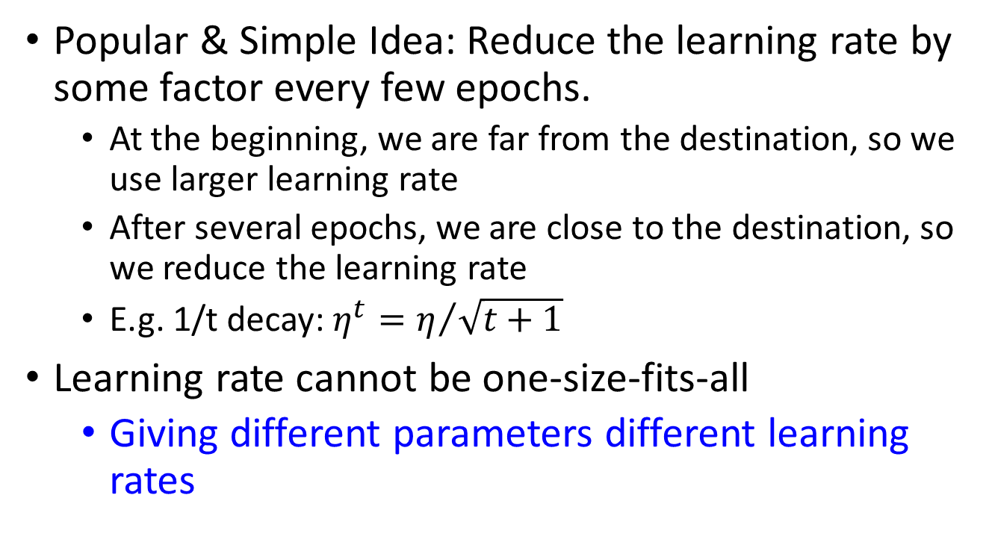
Adaptive Learning Rates
Popular & Simple Idea: Reduce the learning rate by some factor every few epochs.
At the beginning, we are far from the destination, so we use larger learning rate
After several epochs, we are close to the destination, so we reduce the learning rate
E.g. 1/t decay: $η^{t}=η/{\sqrt{t+1}}$
Learning rate cannot be one-size-fits-all
Giving different parameters different learning rates

Slide 8
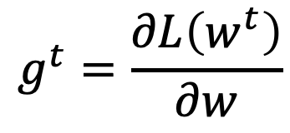
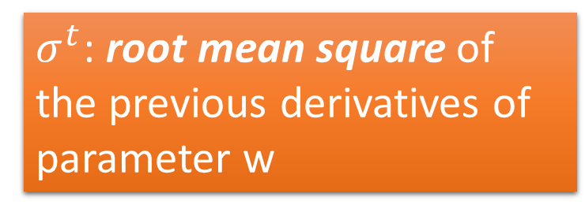
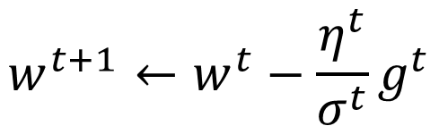


Adagrad
$$η^{t}=\frac{η}{\sqrt{t+1}}$$
$$g^{t}=\frac{∂L\left(w^{t}\right)}{∂w}$$
Divide the learning rate of each parameter by the root mean square of its previous derivatives
Vanilla Gradient descent
$$w^{t+1}←w^{t}−{\text{η}}^{t}g^{t}$$
w is one parameter
Adagrad
$σ^{t}$: root mean square of the previous derivatives of parameter w
$$w^{t+1}←w^{t}−\frac{{\text{η}}^{t}}{σ^{t}}g^{t}$$
Parameter dependent

Slide 9
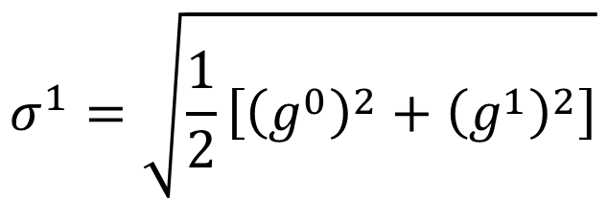
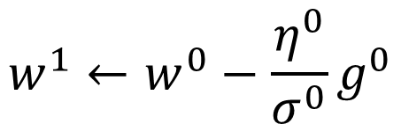


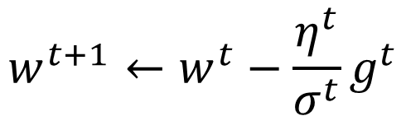
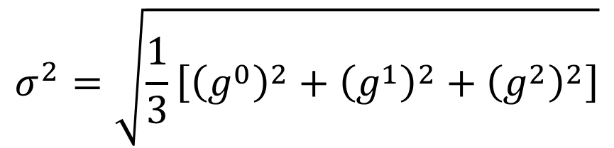
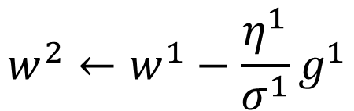
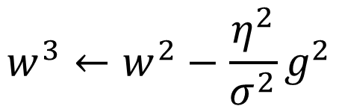

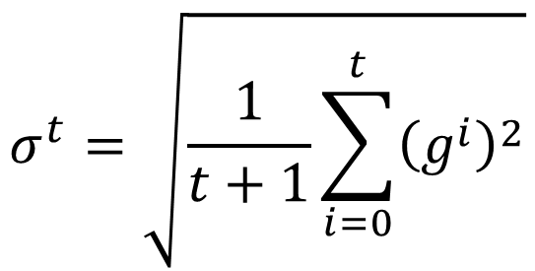
Adagrad
$σ^{t}$: root mean square of the previous derivatives of parameter w
$$w^{1}←w^{0}−\frac{{\text{η}}^{0}}{σ^{0}}g^{0}$$
$$σ^{0}=\sqrt{{\left(g^{0}\right)}^{2}}$$
$$σ^{1}=\sqrt{\frac{1}{2}\left[{\left(g^{0}\right)}^{2}+{\left(g^{1}\right)}^{2}\right]}$$
$$w^{2}←w^{1}−\frac{{\text{η}}^{1}}{σ^{1}}g^{1}$$
$$σ^{2}=\sqrt{\frac{1}{3}\left[{\left(g^{0}\right)}^{2}+{\left(g^{1}\right)}^{2}+{\left(g^{2}\right)}^{2}\right]}$$
$$w^{3}←w^{2}−\frac{{\text{η}}^{2}}{σ^{2}}g^{2}$$
$$……$$
$$σ^{t}=\sqrt{\frac{1}{t+1}\sum_{i=0}^{t}{{\left(g^{i}\right)}^{2}}}$$
$$w^{t+1}←w^{t}−\frac{{\text{η}}^{t}}{σ^{t}}g^{t}$$

Slide 10




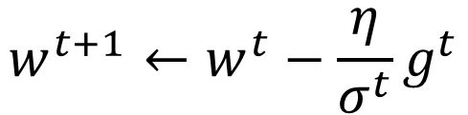
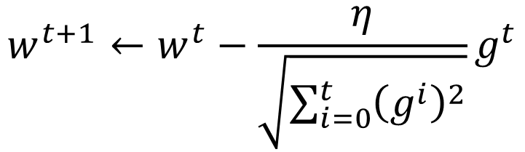
Adagrad
Divide the learning rate of each parameter by the root mean square of its previous derivatives
$$η^{t}=\frac{η}{\sqrt{t+1}}$$
1/t decay
$${\text{η}}^{t}$$
$$w^{t+1}←w^{t}−\frac{η}{σ^{t}}g^{t}$$
$$σ^{t}=\sqrt{\frac{1}{t+1}\sum_{i=0}^{t}{{\left(g^{i}\right)}^{2}}}$$
$$σ^{t}$$
$$w^{t+1}←w^{t}−\frac{η}{\sqrt{\sum_{i=0}^{t}{{\left(g^{i}\right)}^{2}}}}g^{t}$$

Slide 11

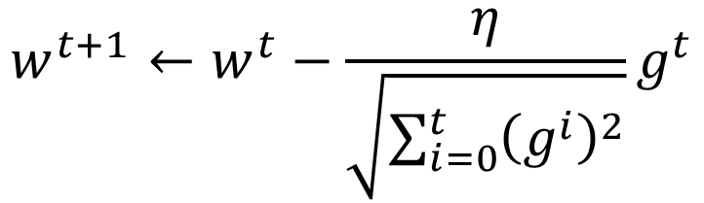
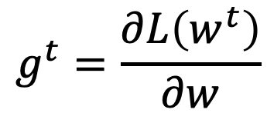

Contradiction?
$$η^{t}=\frac{η}{\sqrt{t+1}}$$
$$g^{t}=\frac{∂L\left(w^{t}\right)}{∂w}$$
Vanilla Gradient descent
Larger gradient,
larger step
$$w^{t+1}←w^{t}−{\text{η}}^{t}g^{t}$$
Adagrad
Larger gradient,
larger step
$$w^{t+1}←w^{t}−\frac{η}{\sqrt{\sum_{i=0}^{t}{{\left(g^{i}\right)}^{2}}}}g^{t}$$
Larger gradient, smaller step

Slide 12
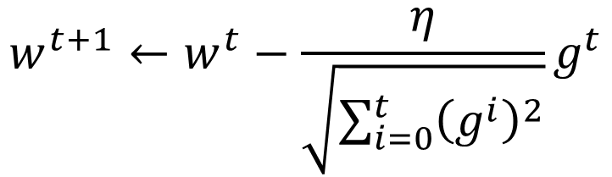

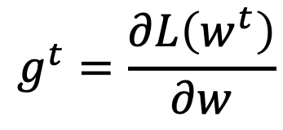
Intuitive Reason
$$η^{t}=\frac{η}{\sqrt{t+1}}$$
$$g^{t}=\frac{∂L\left(w^{t}\right)}{∂w}$$
How surprise it is
Contrast
Too Big
g⁰ | g¹ | g² | g³ | g⁴ | ……
0.001 | 0.001 | 0.003 | 0.002 | 0.1 | ……
g⁰ | g¹ | g² | g³ | g⁴ | ……
10.8 | 20.9 | 31.7 | 12.1 | 0.1 | ……
Too Small
$$w^{t+1}←w^{t}−\frac{η}{\sqrt{\sum_{i=0}^{t}{{\left(g^{i}\right)}^{2}}}}g^{t}$$
The reason of contrast

Slide 13
Gradient Descent
Tip 2: Stochastic
Gradient Descent
Make the training faster

Slide 14
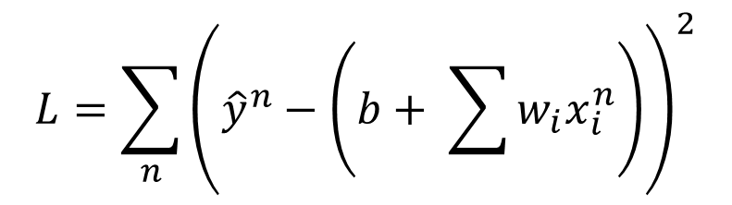
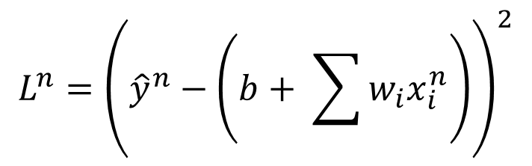
Stochastic Gradient Descent
$$L=\sum_{n}{{\left({\hat{y}}^{n}−\left(b+ \sum{w_{i}x_{i}^{n}}\right)\right)}^{2}}$$
Loss is the summation over all training examples
Gradient Descent
Stochastic Gradient Descent
Faster!
Pick an example x^{n}
$$L^{n}={\left({\hat{y}}^{n}−\left(b+ \sum{w_{i}x_{i}^{n}}\right)\right)}^{2}$$
Loss for only one example

Slide 15
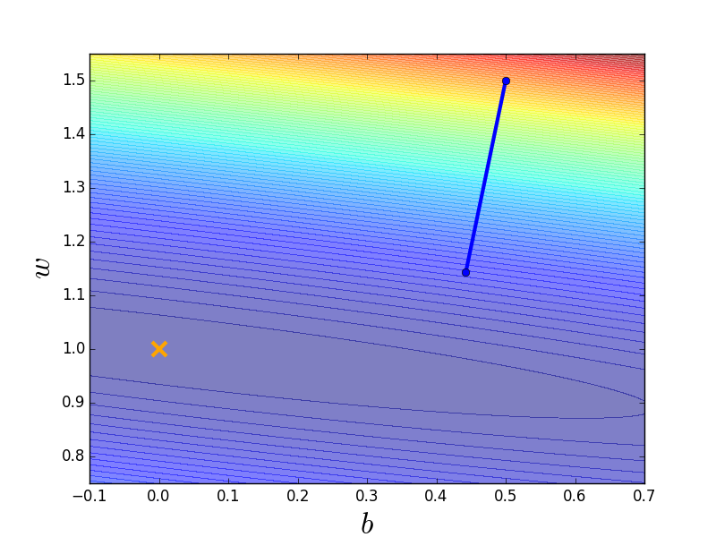
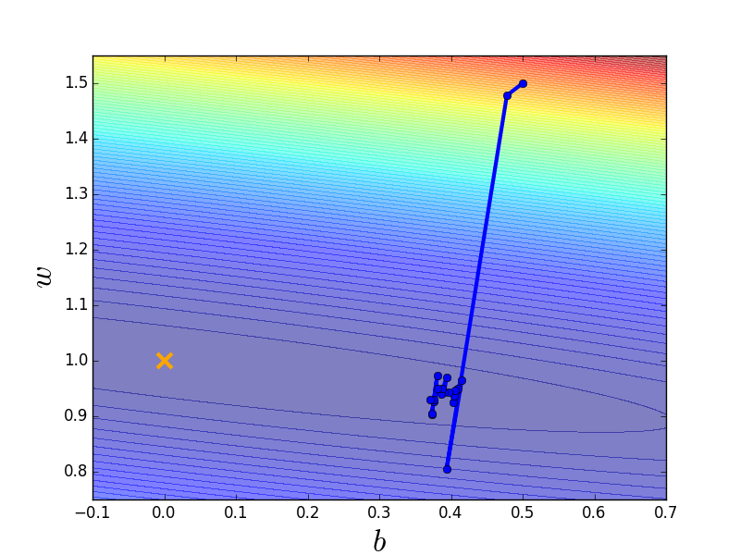
Stochastic Gradient Descent
Stochastic Gradient Descent
Gradient Descent
Update for each example
Update after seeing all examples
If there are 20 examples,
20 times faster.
See all examples
See only one example
See all examples

Slide 16
Gradient Descent
Tip 3: Feature Scaling

Slide 17
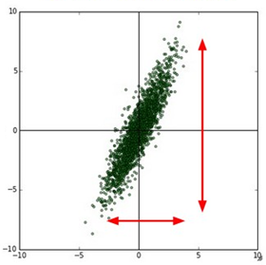
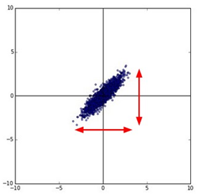





Feature Scaling
Source of figure: http://cs231n.github.io/neural-networks-2/
$$y=b+w_{1}x_{1}+w_{2}x_{2}$$
$$x_{2}$$
$$x_{2}$$
$$x_{1}$$
$$x_{1}$$
Make different features have the same scaling

Slide 18

Feature Scaling
$$y=b+w_{1}x_{1}+w_{2}x_{2}$$
1, 2 ……
1, 2 ……
100, 200 ……
1, 2 ……
Loss L
Loss L

Slide 19
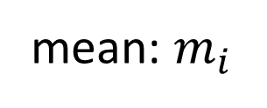







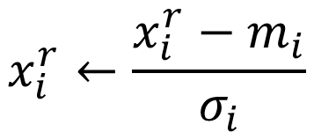

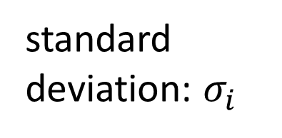

Feature Scaling
$$x^{1}$$
$$x^{2}$$
$$x^{3}$$
$$x^{r}$$
$$x^{R}$$
$$x_{1}^{1}$$
$$x_{1}^{2}$$
For each dimension i:
$$x_{2}^{1}$$
$$x_{2}^{2}$$
……
……
mean: $m_{i}$
……
……
……
……
……
standard deviation: $σ_{i}$
$$x_{i}^{r}←\frac{x_{i}^{r}−m_{i}}{σ_{i}}$$
The means of all dimensions are 0, and the variances are all 1

Slide 20
Gradient Descent
Theory

Slide 21


Question
When solving:
Each time we update the parameters, we obtain $θ$ that makes $L\left(θ\right)$ smaller.
$$θ^{∗}=arg\min_{θ}{L\left(θ\right)}$$
by gradient descent
$$L\left(θ^{0}\right)>L\left(θ^{1}\right)>L\left(θ^{2}\right)>…$$
Is this statement correct?

Slide 22
Warning of Math

Slide 23
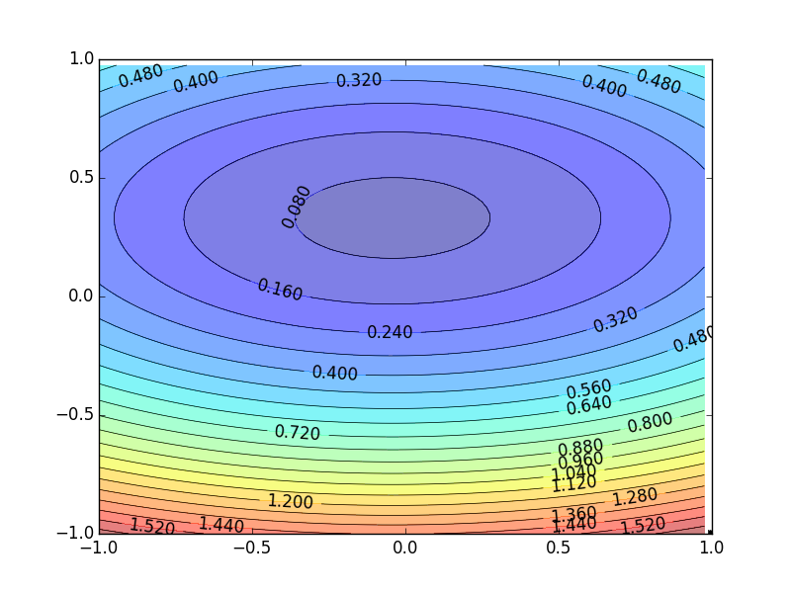
Formal Derivation
L(θ)
Suppose that θ has two variables {θ₁, θ₂}
Given a point, we can easily find the point with the smallest value nearby.
How?

Slide 24
Taylor Series
Taylor series: Let h(x) be any function infinitely differentiable around x = x₀.
When x is close to x₀

Slide 25
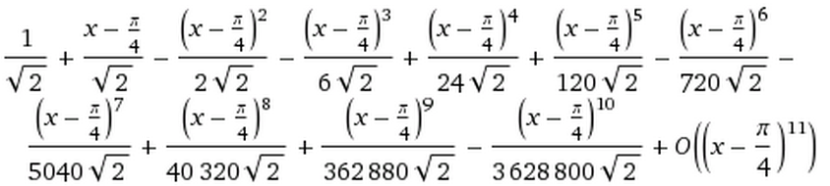
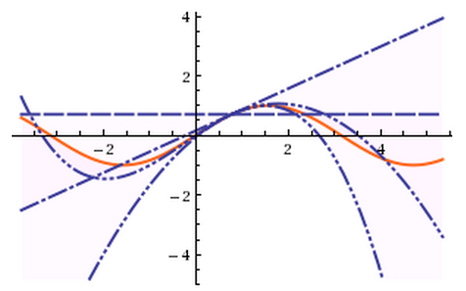
E.g. Taylor series for h(x)=sin(x) around x₀=π/4
sin(x)=
……
The approximation is good around π/4.

Slide 26
Multivariable Taylor Series
+ something related to (x-x₀)² and (y-y₀)² + ……
When x and y is close to x₀ and y₀

Slide 27
Back to Formal Derivation
Based on Taylor Series:
If the red circle is small enough, in the red circle
L(θ)

Slide 28
Back to Formal Derivation
Based on Taylor Series:
constant
If the red circle is small enough, in the red circle
Find θ₁ and θ₂ in the red circle minimizing L(θ)
L(θ)
Simple, right?
d

Slide 29
Gradient descent – two variables
Red Circle:
(If the radius is small)
Find θ₁ and θ₂ in the red circle minimizing L(θ)
To minimize L(θ)

Slide 30
Back to Formal Derivation
Based on Taylor Series:
constant
If the red circle is small enough, in the red circle
Find $θ_{1}$ and $θ_{2}$ yielding the smallest value of $L\left(θ\right)$ in the circle
This is gradient descent.
Not satisfied if the red circle (learning rate) is not small enough
You can consider the second order term, e.g. Newton’s method.

Slide 31
End of Warning

Slide 32
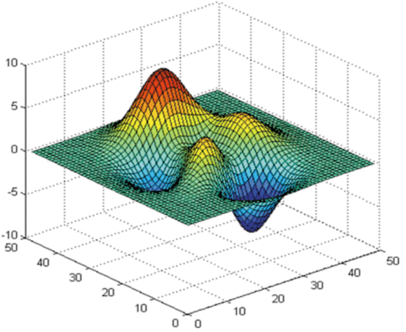






More Limitation of Gradient Descent
Loss
Very slow at the plateau
$$L$$
Stuck at saddle point
$$w_{1}$$
$$w_{2}$$
Stuck at local minima
$$∂L∕∂w$$
$$≈0$$
$$∂L∕∂w$$
$$=0$$
$$∂L∕∂w$$
$$=0$$
The value of the parameter w

Slide 33
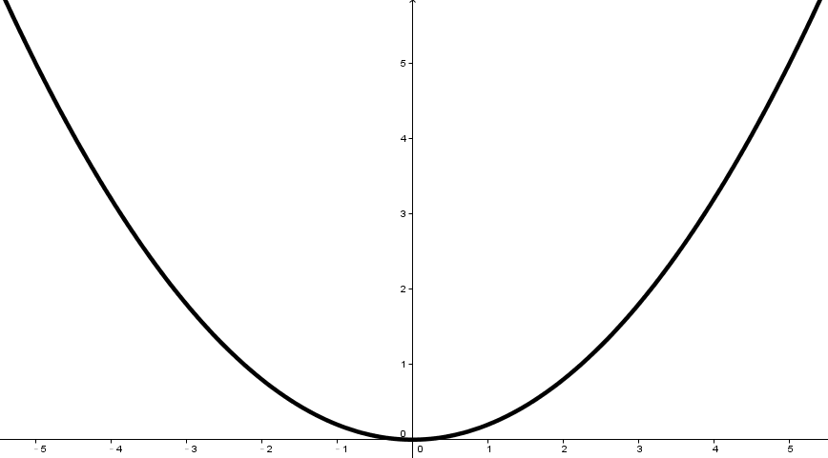
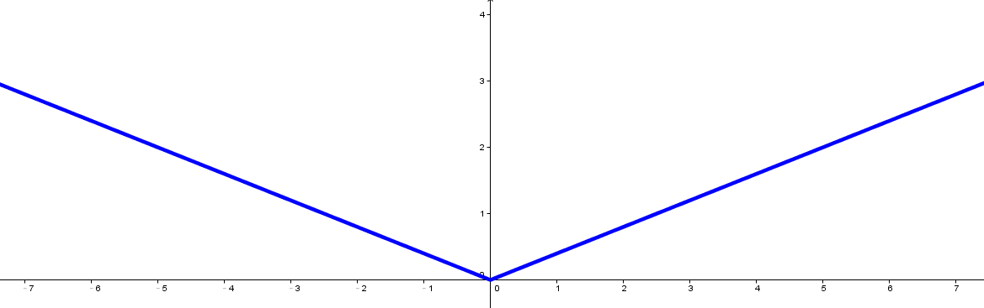


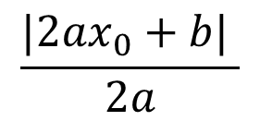





Larger gradient, larger steps?
Best step:
$$|x_{0}+\frac{b}{2a}|$$
$$\frac{|2ax_{0}+b| }{2a}$$
Larger 1st order derivative means far from the minima
$$x_{0}$$
$$−\frac{b}{2a}$$
$$y=ax^{2}+bx+c$$
$$|2ax_{0}+b|$$
$$\left|\frac{∂y}{∂x}\right|=|2ax+b|$$
$$x_{0}$$

Slide 34







Comparison between different parameters
Larger 1st order derivative means far from the minima
Do not cross parameters
a > b
a
b
$$w_{1}$$
$$w_{2}$$
c
c > d
d
$$w_{1}$$
$$w_{2}$$
Notes:
Smaller Learning
Rate

Slide 35









Second Derivative
Best step:
$$|x_{0}+\frac{b}{2a}|$$
$$\frac{|2ax_{0}+b| }{2a}$$
$$−\frac{b}{2a}$$
$$x_{0}$$
$$y=ax^{2}+bx+c$$
$$|2ax_{0}+b|$$
$$\left|\frac{∂y}{∂x}\right|=|2ax+b|$$
$$x_{0}$$
$$\frac{∂^{2}y}{∂x^{2}}=2a$$
|First derivative|
The best step is
Second derivative

Slide 36
Comparison between different parameters
Larger 1st order derivative means far from the minima
Do not cross parameters
|First derivative|
The best step is
Second derivative
a > b
Larger
Second
a
b
$$w_{1}$$
smaller second derivative
$$w_{2}$$
c
c > d
Smaller
Second
d
$$w_{1}$$
$$w_{2}$$
Larger second derivative

Slide 37







The best step is
$$w^{t+1}←w^{t}−\frac{η}{\sqrt{\sum_{i=0}^{t}{{\left(g^{i}\right)}^{2}}}}g^{t}$$
|First derivative|
Second derivative
?
Use first derivative to estimate second derivative
larger second derivative
smaller second derivative
$$w_{1}$$
$$w_{2}$$
$$\sqrt{{\left(first derivative\right)}^{2}}$$

